Slide 1
Database Systems
Lab 10

Slide 2
Objectives
After completing this lesson, you should be able to do the following:
BASIC LOOP
FOR LOOP
WHILE LOOP
Distinguish between an implicit and an explicit cursor
Use a PL/SQL record variable
Write a cursor FOR loop
Notes:
Lesson Aim
In this lesson, you will learn the differences between implicit and explicit cursors. You will also learn when and why to use an explicit cursor.
You may need to use a multiple-row SELECT statement in PL/SQL to process many rows. To accomplish this, you declare and control explicit cursors, which are used in loops, including the cursor FOR loop.

Slide 3
PL/SQL: Loops
Simple Loops Run until you explicitly end the loop
WHILE Loops Run until a specified condition occurs
FOR Loops Run a predetermined number of times

Slide 4
Simple Loops
A simple loop runs until you explicitly end the loop.
Syntax:
LOOP
Statements
END LOOP;

Slide 5
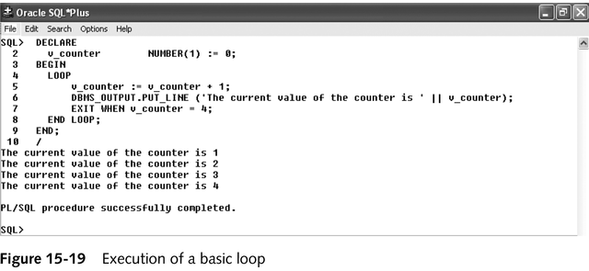
Basic Loop Example

Slide 6
FOR Loops
Syntax:
FOR Loop_variable IN lower_bound . . upper_bound LOOP
Statements
END LOOP;
Example:
FOR count2 IN 1 . . 5 LOOP
DBMS_OUTPUT.PUT_LINE (count2);
END LOOP;

Slide 7
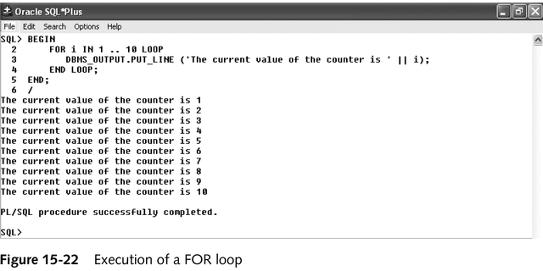
FOR Loop Example

Slide 8
While Loops
A While loop runs until a specified condition occurs.
Syntax:
WHILE condition LOOP
Statements
END LOOP;
Example:
Counter := 0;
WHILE counter <6 LOOP
Counter := counter +1;
END LOOP;

Slide 9
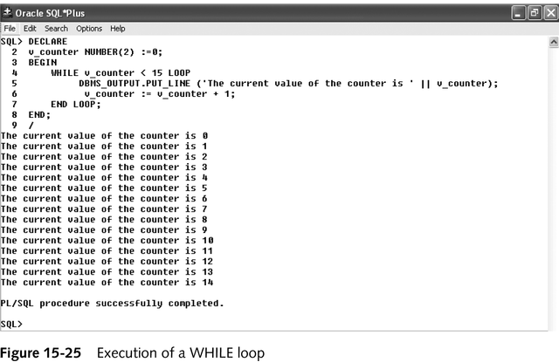
WHILE Loop Example

Slide 10
Nested Loops
Any type of loop can be nested inside another loop
Execution of the inner loop must be completed before control is returned to the outer loop

Slide 11
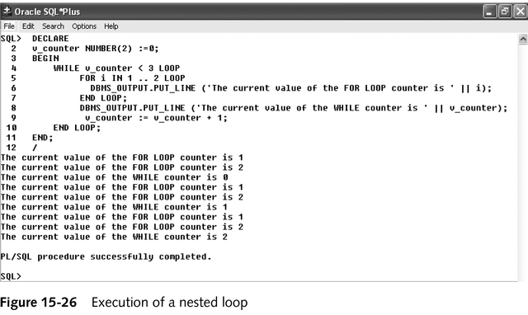
Nested Loop Example

Slide 12
PL/SQL: Cursors
You use cursor when you have a SELECT statement that returns more than one row from the database. A cursor is basically a set of rows that you can access one at a time.
Every SQL statement executed by the Oracle Server has an individual cursor associated with it:
Implicit cursors: Declared for all DML and PL/SQL SELECT statements
Explicit cursors: Declared and named by the programmer

Slide 13
Explicit Cursor Functions
Active set
7369 SMITH CLERK
7566 JONES MANAGER
7788 SCOTT ANALYST
7876 ADAMS CLERK
7902 FORD ANALYST
Cursor
Current row
Notes:
Explicit Cursors
Use explicit cursors to individually process each row returned by a multiple-row SELECT statement.
The set of rows returned by a multiple-row query is called the active set. Its size is the number of rows that meet your search criteria. The diagram on the slide shows how an explicit cursor “points” to the current row in the active set. This allows your program to process the rows one at a time.
A PL/SQL program opens a cursor, processes rows returned by a query, and then closes the cursor. The cursor marks the current position in a active set.
Explicit cursor functions:
Can process beyond the first row returned by the query, row by row
Keep track of which row is currently being processed
Allow the programmer to manually control them in the PL/SQL block
Note: The fetch for an implicit cursor is an array fetch, and the existence of a second row still raises the TOO_MANY_ROWS exception. Furthermore, you can use explicit cursors to perform multiple fetches and to re-execute parsed queries in the work area.

Slide 14
Controlling Explicit Cursors
No
DECLARE
OPEN
FETCH
Yes
CLOSE
EMPTY?
Create a named SQL area
Identify the active set
Load the current row into variables
Test for existing rows
Release the active set
Return to FETCH if rows found
Notes:
Explicit Cursors (continued)
Now that you have a conceptual understanding of cursors, review the steps to use them. The syntax for each step can be found on the following pages.
Controlling Explicit Cursors Using Four Commands
1. Declare the cursor by naming it and defining the structure of the query to be performed within it.
2. Open the cursor. The OPEN statement executes the query and binds any variables that are referenced. Rows identified by the query are called the active set and are now available for fetching.
3. Fetch data from the cursor. The FETCH statement loads the current row from the cursor into variables. Each fetch causes the cursor to move its pointer to the next row in the active set. Therefore, each fetch accesses a different row returned by the query. In the flow diagram shown on the slide, each fetch tests the cursor for any existing rows. If rows are found, the fetch loads the current row into variables; otherwise, it closes the cursor.
4. Close the cursor. The CLOSE statement releases the active set of rows. It is now possible to reopen the cursor to establish a fresh active set.

Slide 15
Controlling Explicit Cursors
Open the cursor.
Pointer
Cursor
Fetch a row from the cursor.
Pointer
Cursor
Continue until empty.
Pointer
Cursor
Close the cursor.
Cursor
Notes:
Explicit Cursors (continued)
You use the OPEN, FETCH, and CLOSE statements to control a cursor. The OPEN statement executes the query associated with the cursor, identifies the active set, and positions the cursor (pointer) before the first row. The FETCH statement retrieves the current row and advances the cursor to the next row. When the last row has been processed, the CLOSE statement disables the cursor.

Slide 16
Explicit Cursor Attributes
Obtain status information about a cursor.
Attribute Type Description
%ISOPEN Boolean Evaluates to TRUE if the cursor is open
%NOTFOUND Boolean Evaluates to TRUE if the most recent fetch does not return a row
%FOUND Boolean Evaluates to TRUE if the most recent fetch returns a row; complement of %NOTFOUND
%ROWCOUNT Number Evaluates to the total number of rows returned so far
Notes:
Explicit Cursor Attributes
As with implicit cursors, there are four attributes for obtaining status information about a cursor. When appended to the cursor variable name, these attributes return useful information about the execution of a data manipulation statement.
Note: You cannot reference cursor attributes directly in a SQL statement.

Slide 17
Controlling Multiple Fetches
Process several rows from an explicit cursor using a loop.
Fetch a row with each iteration.
Use the %NOTFOUND attribute to write a test for an unsuccessful fetch.
Use explicit cursor attributes to test the success of each fetch.
Notes:
Controlling Multiple Fetches from Explicit Cursors
To process several rows from an explicit cursor, you typically define a loop to perform a fetch on each iteration. Eventually all rows in the active set are processed, and an unsuccessful fetch sets the %NOTFOUND attribute to TRUE. Use the explicit cursor attributes to test the success of each fetch before any further references are made to the cursor. If you omit an exit criterion, an infinite loop results.
For more information, see PL/SQL User’s Guide and Reference, Release 8, “Interaction With Oracle.”
Class Management Note
The reference manual contains a table of cursor values, which is useful for evaluating the attribute value before and after each phase of the cursor management.

Slide 18
The %ISOPEN Attribute
Fetch rows only when the cursor is open.
Use the %ISOPEN cursor attribute before performing a fetch to test whether the cursor is open.
Example
IF NOT emp_cursor%ISOPEN THEN
OPEN emp_cursor;
END IF;
LOOP
FETCH emp_cursor...
Notes:
Explicit Cursor Attributes
You can fetch rows only when the cursor is open. Use the %ISOPEN cursor attribute to determine whether the cursor is open, if necessary.
Fetch rows in a loop. Use cursor attributes to determine when to exit the loop.
Use the %ROWCOUNT cursor attribute to retrieve an exact number of rows, fetch the rows in a numeric FOR loop, or fetch the rows in a simple loop and determine when to exit the loop.
Note: %ISOPEN returns the status of the cursor: TRUE if open and FALSE if not. It is not usually necessary to inspect %ISOPEN.

Slide 19
The %NOTFOUND and %ROWCOUNT Attributes
Use the %ROWCOUNT cursor attribute to retrieve an exact number of rows.
Use the %NOTFOUND cursor attribute to determine when to exit the loop.
Notes:
Example
Retrieve the first 10 employees one by one.
Note: Before the first fetch, %NOTFOUND evaluates to NULL. So if FETCH never executes successfully, the loop is never exited. That is because the EXIT WHEN statement executes only if its WHEN condition is true. To be safe, you might want to use the following EXIT statement:
If using %ROWCOUNT, add a test for no rows in the cursor by using the %NOTFOUND attribute, because the row count is not incremented if the fetch does not retrieve any rows.
DECLARE
v_empno emp.empno%TYPE;
v_ename emp.ename%TYPE;
CURSOR emp_cursor IS
SELECT empno, ename
FROM emp;
BEGIN
OPEN emp_cursor;
LOOP
FETCH emp_cursor INTO v_empno, v_ename;
EXIT WHEN emp_cursor%ROWCOUNT > 10 OR emp_cursor%NOTFOUND;
...
END LOOP;
CLOSE emp_cursor;
END ;
EXIT WHEN emp_cursor%NOTFOUND OR emp_cursor%NOTFOUND IS NULL;

Slide 20
Defining a Cursor
Declare variables to store column values from the SELECT statement.
Declare the cursor, specifying your SELECT statement.
Open the Cursor.
Fetch the rows from the cursor.
Close the cursor.

Slide 21
STEP 1 : Declare variables to store column values
These variables must be compatible with the column types.
DECLARE
v_Empno emp.empno%TYPE;
v_Ename emp.ename%TYPE;
v_Job emp.job%TYPE;
v_Deptno emp.deptno%TYPE;
v_Sal emp.sal%TYPE;

Slide 22
STEP 2: Declare the cursor
CURSOR cursor_name IS
SELECT_STATEMENT;
---
CURSOR cv_emp_cursor IS
SELECT empno,ename,sal
FROM emp
Order by empno;

Slide 23
STEP 3: Open the Cursor
This step runs the SELECT statement. It must be placed in the executable section of the block (BEGIN).
OPEN cv_emp_cursor;

Slide 24
STEP 4: Fetch the rows from the cursor
Syntax:
FETCH cursor_name
INTO variable[, variable. . . . ];
Example:
FETCH cv_emp_cursor
INTO v_Empno ,v_Ename , v_Job , v_Deptno ,v_Sal;
A cursor may have many rows; therefore, a loop is required to read each row in turn.
LOOP
FETCH CV_EMP_CURSOR
INTO V_EMPNO ,V_ENAME , V_JOB , V_DEPTNO ,V_SAL;
--exit the loop when there are no more rows, as indicated by
--the Boolean variable cv_emp_cursor%NOTFOUND (=true when
--there are no more rows)
EXIT WHEN cv_emp_cursor%NOTFOUND;
--use DBMS_OUTPUT.PUT_LINE () to display the variable
DBMS_OUTPUT.PUT_LINE(
‘v_Empno= ‘ || v_Empno ,’v_Ename=’ || v_ename ,’ v_Job= ‘ || v_job , ‘ v_Deptno= ‘ || v_Deptno ,’v_Sal = ‘|| v_sal;

Slide 25
STEP 5: Close the Cursor
Closing your cursors frees up system resources.
CLOSE cv_emp_cursor;

Slide 26
Cursors and Records
Process the rows of the active set conveniently by fetching values into a PL/SQL RECORD.
Example
DECLARE
CURSOR emp_cursor IS
SELECT empno, ename
FROM emp;
emp_record emp_cursor%ROWTYPE;
BEGIN
OPEN emp_cursor;
LOOP
FETCH emp_cursor INTO emp_record;
...
Notes:
Cursors and Records
You have already seen that you can define records to use the structure of columns in a table. You can also define a record based on the selected list of columns in an explicit cursor. This is convenient for processing the rows of the active set, because you can simply fetch into the record. Therefore, the values of the row are loaded directly into the corresponding fields of the record.
Example: Use a cursor to retrieve employee numbers and names and populate a temporary database table with this information.
DECLARE
CURSOR emp_cursor IS
SELECT empno, ename
FROM emp;
emp_record emp_cursor%ROWTYPE;
BEGIN
OPEN emp_cursor;
LOOP
FETCH emp_cursor INTO emp_record;
EXIT WHEN emp_cursor%NOTFOUND;
INSERT INTO temp_list (empid, empname)
VALUES (emp_record.empno, emp_record.ename);
END LOOP;
COMMIT;
CLOSE emp_cursor;
END ;

Slide 27
PL/SQL: Cursors and FOR Loops
You can use the power of FOR loop to access the rows in a cursor
When you use a FOR loop, you don’t have to explicitly open and close the cursor------ the FOR loop does this automatically.

Slide 28
Cursor FOR Loops
Syntax
The cursor FOR loop is a shortcut to process explicit cursors.
Implicit open, fetch, and close occur.
The record is implicitly declared.
FOR record_name IN cursor_name LOOP
statement1;
statement2;
. . .
END LOOP;
Notes:
Cursor FOR Loops
A cursor FOR loop processes rows in an explicit cursor. It is a shortcut because the cursor is opened, rows are fetched once for each iteration in the loop, and the cursor is closed automatically when all rows have been processed. The loop itself is terminated automatically at the end of the iteration where the last row was fetched.
In the syntax:
record_name is the name of the implicitly declared record
cursor_name is a PL/SQL identifier for the previously declared cursor
Guidelines
Do not declare the record that controls the loop. Its scope is only in the loop.
Test the cursor attributes during the loop, if required.
Supply the parameters for a cursor, if required, in parentheses following the cursor name in the FOR statement. More information on cursor parameters is covered in a subsequent lesson.
Do not use a cursor FOR loop when the cursor operations must be handled manually.
Note: You can define a query at the start of the loop itself. The query expression is called a SELECT substatement, and the cursor is internal to the FOR loop. Because the cursor is not declared with a name, you cannot test its attributes.

Slide 29
Cursor FOR Loops
Retrieve employees one by one until no more are left.
Example
DECLARE
CURSOR emp_cursor IS
SELECT ename, deptno
FROM emp;
BEGIN
FOR emp_record IN emp_cursor LOOP
-- implicit open and implicit fetch occur
IF emp_record.deptno = 30 THEN
...
END LOOP; -- implicit close occurs
END;
Notes:
Example
Retrieve employees one by one and print out a list of those employees currently working in the Sales department. The example from the slide is completed below.
Class Management Note
Point out the similarities between a cursor FOR loop and a numeric FOR loop; a numeric FOR loop specifies a range of numeric values and then takes on each value within that range; a cursor FOR loop specifies a range of rows from a database table and then retrieves each row within that range.
SET SERVEROUTPUT ON
DECLARE
CURSOR emp_cursor IS
SELECT ename, deptno
FROM emp;
BEGIN
FOR emp_record IN emp_cursor LOOP
--implicit open and implicit fetch occur
IF emp_record.deptno = 30 THEN
DBMS_OUTPUT.PUT_LINE ('Employee ' || emp_record.ename
|| ' works in the Sales Dept. ');
END IF;
END LOOP; --implicit close occurs
END ;
/

Slide 30
Cursor FOR Loops Using Subqueries
No need to declare the cursor.
Example
BEGIN
FOR emp_record IN ( SELECT ename, deptno
FROM emp) LOOP
-- implicit open and implicit fetch occur
IF emp_record.deptno = 30 THEN
...
END LOOP; -- implicit close occurs
END;
Notes:
Cursor FOR Loops Using Subqueries
You do not need to declare a cursor because PL/SQL lets you substitute a subquery. This example does the same thing as the one on the previous page. It is complete code for the slide above.
Class Management Note
This syntax simplifies the coding of cursors, but you cannot define a cursor with parameters.
SET SERVEROUTPUT ON
BEGIN
FOR emp_record IN (SELECT ename, deptno
FROM emp) LOOP
--implicit open and implicit fetch occur
IF emp_record.deptno = 30 THEN
DBMS_OUTPUT.PUT_LINE ('Employee ' || emp_record.ename
|| ' works in the Sales Dept. ');
END IF;
END LOOP; --implicit close occurs
END ;
/

Slide 31
Example: Cursors and FOR Loops
DECLARE
CURSOR cv_emp_cursor2 IS
SELECT empno, ename,job
FROM emp WHERE deptno = 30;
BEGIN
FOR v_emp IN cv_emp_cursor2 LOOP
DBMS_OUTPUT.PUT_LINE(
‘EMPNO =’ || v_emp.empno || ‘,ename = ‘|| v_emp.ename || ‘,job = ‘|| v_emp.job );
END LOOP;
END;

